Slide 1
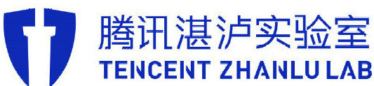
Security Analysis on the Attack Surfaces of Blockchain Client
Chen Nan & Kame Wang
Zhanlu Lab, Tencent Inc.
Notes:
hello, ladies and gentlemen, it’s my honor to be here,
my name is chennan, this is my partner kame wang.
we are come from tencent,zhanlu lab
our topic is Security Analysis(an na le sei si) on the Attack Surfaces of Blockchain Client

Slide 2
About Us
Chen Nan
Main focus: Blockchain, Windows Kernel, Virtualization;
Speaker of 44con 2018, CSS 2018;
Discovered 10+ vulnerabilities of blockchain client.
Kame Wang
PhD of Chinese Academy of Sciences;
Research Interests: Blockchain security, automatic code analysis and test, mobile security;
Speaker of ACM CCS 2016 ( as a PhD student), TSec 2018.
Notes:
First of all, let me introduce myself
i’m a security researcher , my research mainly focuses on the security of blockchain,windows kernel and virtualization.
Hi, I am Kame Wang.
I am a PhD of ……
My research interests include:…..
I used to be a speaker on ACM CCS 2016.
It is one of the top 4 academy conferences on information security.
Last year, I also made a speech on Tsec conference which was held in Beijing.

Slide 3
About Zhanlu Lab
Yuange, one of the most famous hackers from China
3 Researchers on MSRC TOP100 in 2018.
Pwn2own2017 winner , as Tencent Security Lance Team
Twitter: @ZhanluLab
Notes:
We all come from Zhanlu Lab, Tencet Inc.
Our leader is one of the most famous hackers from China, whose id is Yuange.
He is extremely good at vulnerability mining on Windows system.
In the last year, 3 of our researchers are on the MSRC top100.
We are also the winner of Pwn2Own 2017.
If you are interested on us, you can find us on Twitter.

Slide 4
Agenda
Background
Attack Surface Analysis
How to Find Vulnerabilities
Real Cases
Conclusion
Notes:
The agenda of our talk is here.
We will firstly introduce the background of our research.
And then, the attack surfaces of block chain nodes will be presented.
Thirdly, we will show some tricks to find vulnerabilities in these attack surfaces.
Some real cases of vulnerabilities will also be presented.
In the end, we will make a short conclusion.

Slide 5
Agenda
Background
Attack Surface Analysis
How to Find Vulnerabilities
Real Cases
Conclusion

Slide 6
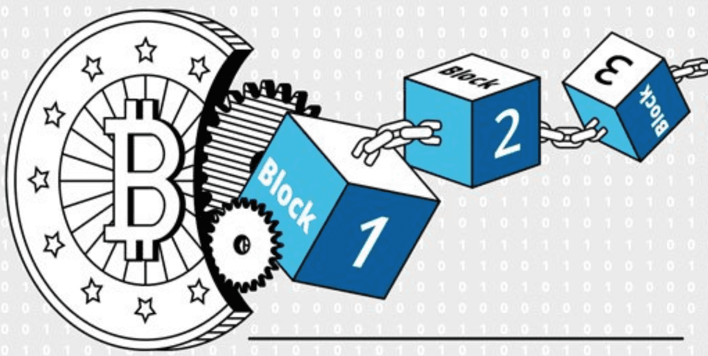
What is Blockchain
Its nature: Distributed ledger on a P2P network;
Account: A pair of public & private keys;
Account Address: Hash of public key;
Transaction: Signed by private key & broadcast on P2P network;
Block: A page of ledger;
Block Chain: Ledger pages linked
by cryptographic hash;
Mining: Generating new ledger
page to get an award.
Notes:
The nature of block chain is a distributed ledger on a P2P network.
Taking the top public blockchain project as an example.
A user’s digital concurrency account is a pair of public key and private key;
The address of an account is the hash of the public key.
If a user want to make a transaction, he will need to sign the transaction message using his private key and broadcast it onto the P2P network.
This message will include the account address of the sender and the receiver, and the account of digital concurrency and so on.
Blocks can be regarded as pages of ledger.
Block chain can be thought like that these ledger pages are linked together.
The link is usually implemented by record the hash of the previous block into the data of the current block.
For public blockchain project, the generator of new blocks can get award in the format of digital concurrency.
The process of generating new blocks are called mining.

Slide 7
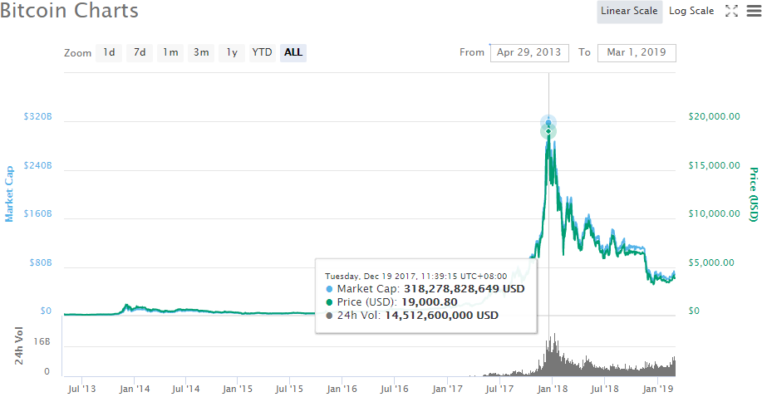





The Rise of Blockchain
Crazy digital currencies：the currency market has increased rapidly.
Top Technique Companies*:
Finance VS Cloud Service Provider
Governments:
USA
European Union
Canada
……
https://bitcoinexchangeguide.com/google-amazon-bank-of-america-mastercard-ibm-and-microsoft-blockchain-patents-are-piling-up/
Notes:
On 2017, represented by Bitcoin, the explosive price rise of digital concurrencies has attracted a lot of attention and interests on blockchain technique.
[CLK]
Besides public block chains, which are usually used to issue digital concurrency, companies are more focus on how to apply blockchain technique on real projects.
The finical companies are most interested on this new technique.
Furthermore, the cloud service providers are also providing solutions for blockchain network.
[CLK]
Many countries are also very supportive for blockchain technique.
For example, on June 2015, America released some sweeping new rules for licensing virtual-currency businesses in New York state.
// Canada: Canada Has Been Experimenting With A Digital Fiat Currency Called CAD-COIN
// European Union: Seven southern European Union member states have released a declaration calling for help in the promotion of Distributed Ledger Technology’s (DLT) use in the region, the Financial Times (FT) reports Dec 2018

Slide 8
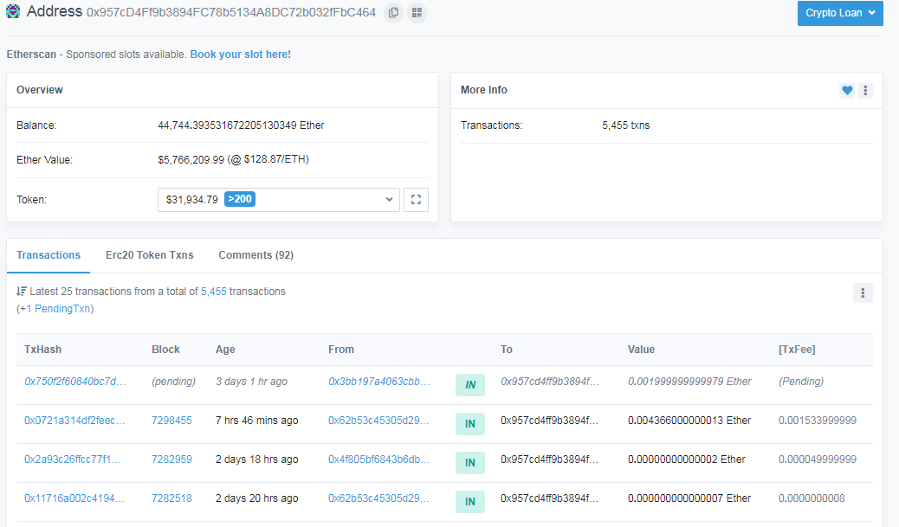
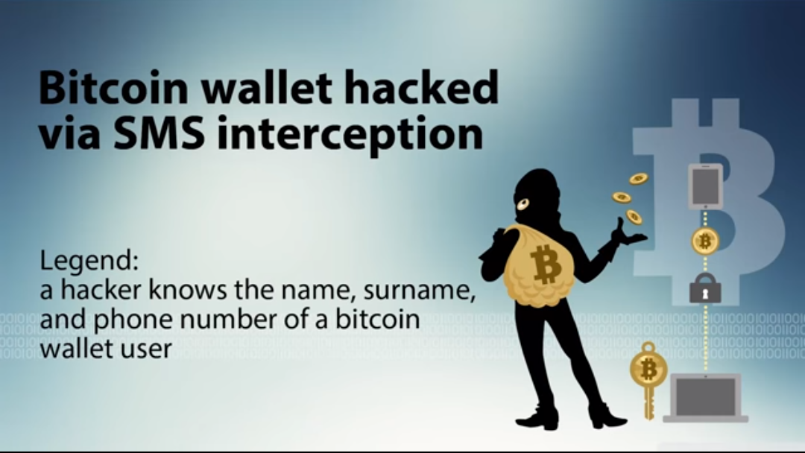

Attacks on Blockchain
Attacks on digital currency owner:
Sep 2017, use the SS7 exploit to snag control of a bitcoin wallet on Coinbase, steal Bitcoins worth $27,000;
Attacks on trading platform:
Jan 2018, Coincheck which is the largest digital currency trading platform in Japan, was hacked for a record $530 million;
Attacks on blockchain network:
Since Feb 2016, Ethereum nodes are suffering from RPC attackers. The most famous attacker has stolen mothan 44,00 Ethers, which worth more than $5,700,000.
Notes:
In sharp contrast to the rapid rise of blockchain technology, the security of blockchain ecosystem is very fragile.
Various attacks have been reported in recent years.
Most direct attacks are targeting on owners of digital concurrency.
The wallet clients are the most attractive target.
[CLK]
Second type of attacks are targeting on trading platforms.
These attacks will result in very serious financial losses.
[CLK]
The last attack type is targeting at the blockchain nodes.
Some common vulnerabilities may exist in the code of blockchain nodes.
Because of the huge amount of nodes, the attacks on these vulnerabilities can also result in a large scare of losses.

Slide 9

Background Summary
A fast-growing new technology with a wide range of applications;
The ecosystem is facing attacks from various aspects.
It’s important to study the security of blockchain.
Notes:
In summary, blockchain is ….
However, its ecosystem is ….
[CLK]
Therefore, it is …

Slide 10
Agenda
Background
Attack Surface Analysis
How to Find Vulnerabilities
Real Cases
Conclusion
Notes:
Now, let’s have a look at the different kinds of attack surfaces of blockchain.

Slide 11
Attack Surfaces
Rmote Node
RPC MSG
P2P MSG
Smart Contract
…
P2P Interface
Smart Contract
RPC
……
Interface
Discover
SYN
Consensus
VM
Syscalls
Protocol
Protocol
Protocol
Block Chain Server Node
Notes:
The attack surfaces of a blockchain network can be divided into 3 major categorizes.
The first is the RPC interface.
RPC is short for the remote procedure call interface.
The second is the P2P interface, which usually contains three main protocols, which are discovery, synchronization and consensus.
The third is smart contract, whose virtual machine is the main attack interface.

Slide 12
RPC Interface
A feature of mainstream blockchain projects:
Core Feathers: wallet, mining, blocks, p2p;
UI: provides a way to config functions or query data;
RPC: the major implementation of UI, usually in the form of JSON-RPC.
Core Feathers
Wallet
Miner
Ethereum
Network
User Interfaces
B
locks
P
2p
Notes:
Let’s have a look in the the RPC interfaces.
RPC is a common feature of mainstream blockchain projects.
[CLK]
For a blockchain node, its core feathers contain wallet management, concurrency mining, block validation and P2P communication.
[CLK]
While a node is running, it should provide a way to config functionalities or query some data of the blockchain.
[CLK]
RPC interface is the major implementation of this kind of UI.
Usually, it is provided in the form of JSON-RPC.

Slide 13

Default Configure of ETH RPC Interface
Safe but configurable.
Client | Language | URL
cpp-ethereum | C++ | http://localhost:8545
go-ethereum | Go | http://localhost:8545
pyethapp | Python | http://localhost:4000
Parity | Rust | http://localhost:8545
ubuntu@VM-0-3-ubuntu:~$ geth --help | grep rpcaddr
--rpcaddr value HTTP-RPC server listening interface (default: "localhost")
Notes:
Taking Ethereum as an example.
It has many versions of node programs, which are developed in various languages.
The default configurations of these clients only expose their RPC interfaces to local host.
However, the combined address can be configured to public internet address, which will expose its RPC functionalities.
As shown in the bottom, it can be done by specifying the one argument, which is rpcaddr.

Slide 14
RPC Modules of ETH
eth: account & transaction;
personal: node owner;
net: network;
miner: block mining;
parity;
……
ubuntu@VM-0-3-ubuntu:~$ geth --rpc
... ...
INFO [05-27|01:32:53] IPC endpoint opened url=/home/ubuntu/.ethereum/geth.ipc
INFO [05-27|01:32:53] HTTP endpoint opened url=http://127.0.0.1:8545
ubuntu@VM-0-3-ubuntu:~$ curl -H "Content-Type: application/json" --data '{"jsonrpc":"2.0","method":"rpc_modules","id":233}' 127.0.0.1:8545
{"jsonrpc":"2.0","id":233,"result":{"eth":"1.0","net":"1.0","rpc":"1.0","web3":"1.0"}}
ubuntu@VM-0-3-ubuntu:~$ geth --help | grep rpcapi
--rpcapi value API's offered over the HTTP-RPC interface
Notes:
Many blockchain projects will divide their interfaces into different modules according to their functions.
For example, the RPC modules of Ethereum can be divided into eth, personal, net, miner and so on.
Some modules are enabled by default.
As shown in the first two boxes, users can query the enabled module list by using rpc_modules interface.
The last box shows that th list can be configured when starting up a node by specifying one argument, which is rpcapi.
Besides, different client programs may provide their own RPC interfaces and modules, such as an Ethereum client named Parity.
It is highlighted in red color.

Slide 15

RPC Attack Demonstration
Public
Network
Core Feathers
Wallet
Miner
Ethereum
Network
User Interfaces
B
locks
P
2p
Notes:
In summary, if a node binds its RPC onto its public address, these exposed RPC interfaces will under the threat of remote attackers.

Slide 16
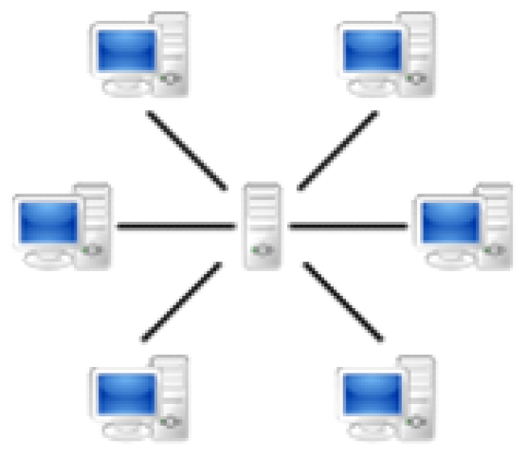
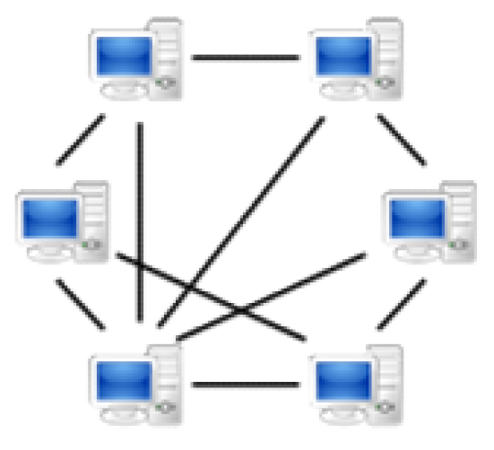
P2P DISCOVER PROTOCOL
p2p networks vs traditional C/S networks. Each node is both a client and a server.
Therefore, a node discovery protocol is needed in p2p systems.
C/S networks
p2p networks
Notes:
ok, next is the p2p discover attack surface.
Firstly, p2p network is different from the traditional c/s network.
It doesn’t have a centralized server; each of its nodes can be a server or a client.
Because the nodes getting in and out of the network is very frequent.
Nodes in such a network are unable to maintain a full amount of routing information .
This requires a way to find the target nodes or resource, that is p2p discover protocol.

Slide 17
P2P DISCOVER PROTOCOL
ETH’s discovery protocol, based on the kademlia algorithm.
https://github.com/ethereum/go-ethereum/tree/master/p2p/discover
https://github.com/ethereum/devp2p/blob/master/discv4.md
Notes:
Let's take the ethereum's p2p discovery protocol as an example.
It‘s a protocol based on kademlia algorithm.
As is shown in the figure, each node keeps a list of seed nodes and a list of neighbor nodes.
The seed nodes are fixed that are maintained alive for a long time .
Neighbors nodes are found through the discovery protocol.
This protocol is based on udp and contains four types of packets.
First, the nodes determine connectivity through pingpong.
Then, send a findnode packet with the target id you're looking for
Your neighbor then returns a set of nodes closest to the target.
Then, you can repeat the process over and over again, like a snowball.
About the implementation details of the protocol, please refer to the source code implementation of Ethereum.

Slide 18
P2P SYN Protocol
A new blockchain node has no local chain-data, so need other nodes to help synchronize them.
Because of network delay, old nodes also need to be synchronized.
Notes:
ok, Next is p2p synchronization attack surface.
The state of nodes in p2p network is very complicated, some are new nodes, some are offline nodes, and some have high network delay.
So we need the synchronization protocol that lets all nodes have the same state.
In the blockchain system, there are usually three types of data synchronization.
They are synchronizing blockchain data, broadcasting block data and broadcasting transaction data.

Slide 19
P2P SYN PROTOCOL
ETH’s Synchronization Timing:
When a new node is added.
When receiving a block from a node.
Positively synchronize every 10 seconds.
ETH’s BroadcastBlock Timing:
When a new block is mined.
When a new block is received.
ETH’s BroadcastTx:
A new transaction is received.
When you send a transaction.
https://github.com/ethereum/go-ethereum/tree/master/eth/downloader
Notes:
Let's take ethereum's p2p synchronization protocol as an example.
The first is synchronizing blockchain
There are some situations to trigger it.
For example, When a new node is added, it will synchronize.
when a new block is received , synchronization is triggered.
In addition, every 10 seconds, it will positively synchronize.
the Second is block broadcast.
When a new block is mined, it will be broadcasted to the entire network.
In addition, when a new block is received, it will also be broadcasted.
the third is Transaction Broadcast.
When a new transaction is received, it will be broadcasted to the entire network.
When you send a transaction, it will also be broadcasted.

Slide 20
P2P CONSENSUS PROTOCOL
Consensus protocol is the core of blockchain.
Because the nodes in the blockchain are all equal, each node has the right to generate block.
So how to determine whose block should be added to the chain.
Consensus protocol could solve this problem
Common consensus protocols:
POW、POS、DPOS、PBFT and so on.
Notes:
ok, Next is p2p consensus attack surface.
Because the nodes in the blockchain are all equal , each node has the right to generate block.
So how to determine whose block should be added to the chain.
Consensus protocol could solve this problem

Slide 21
P2P CONSENSUS PROTOCOL
ETH’s consensus protocol(POW): mine
https://github.com/ethereum/go-ethereum/tree/master/consensus
Notes:
Let's take a look at how the Ethereum’s consensus solves this problem.
Ethereum uses the Proof of Work consensus protocol.
As the name suggests, blocks are selected according to their difficulty, also know as hashrate .
The figure is the generation process of the new block.
A miner will Calculate a hash value which combines transactions information, block information, hash for the previous block, and a nonce number.
This hash is compared with a target value. If the hash value is less than the target value, the mining is successful; otherwise, the above steps are repeated with another nonce number.
When the block is broadcast, the other nodes will validate its difficulty with target value In order to determine whether to accept it or not.

Slide 22
P2P CONSENSUS PROTOCOL
ETH’s consensus protocol(POW):
Notes:
There are a lot of miners in the whole blockchain network
In some cases, a node may receive multiple blocks at the same height and both blocks are legal.
At this point, the node will select one block according to the difficulty of the block.
The difficulty depends on when the block was created.And it also depends the historical difficulty of the chain.

Slide 23
Smart contract interpreting
Usually a smart contract is a binary array which has its own format.
The contract creator develops the contract and sends it to the blockchain nodes.
The blockchain nodes is responsible for parsing and executing the smart contract.
Common smart contracts: Solidity, WASM and so on.
Notes:
ok, Next is Smart contract interpreting attack surface.
Smart contracts are like the SQL script on a database .
It is used to implement business logic on the blockchain platform.
Its code and data are stored on the blockchain.
Usually a smart contract is a binary array. Just like a Windows PE file, it has its own format.
The smart contract creator develops the contract and sends it to the blockchain nodes.
It is transmitted on the basis of transaction.
Users can also invoke smart contracts by sending transactions to nodes.
The blockchain nodes is responsible for parsing and executing the smart contract.

Slide 24
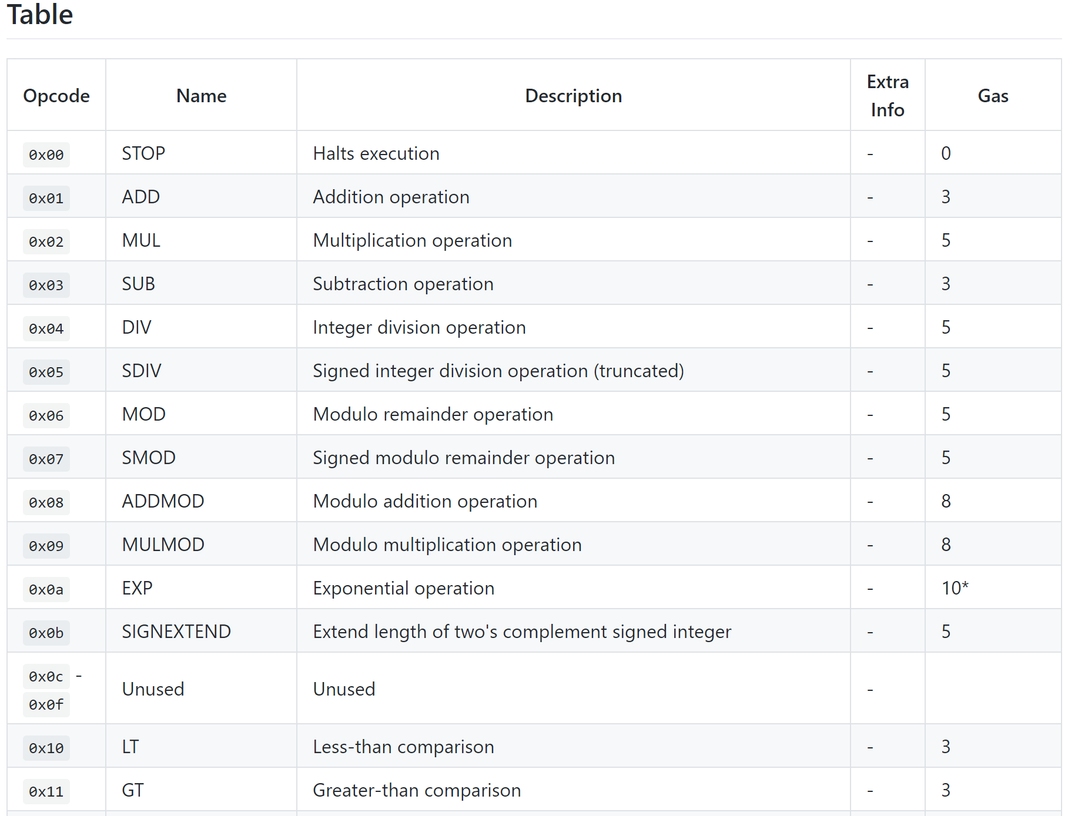
Smart contract interpreting
ETH’s smart contract interpreting:
https://github.com/ethereum/go-ethereum/tree/master/core/vm
Notes:
Let's take a look at how the Ethereum interprets smart contracts.
The figure on the right shows the processing of the smart contract.
First, contract developers write source code with scripting languages, such as solidity.
Then, the source code will be compiled to opcodes bytes.
Next, the bytes are sent to the blockchain network using the transaction.
When mining block or verifying block, it will be deployed.
Smart contract is executed in a stack-based virtual machine. also known as EVM .
The evm is responsible for parsing opcode and parsing parameters and performing operations.
The left figure lists part of evm‘s opcode .
such as add, mul, sub and so on.

Slide 25
Smart Contract Syscall
Because the smart contract and the client are in different execution contexts.
Contract can not do some Client-side operations.
The client provides some APIs for the smart contract, which is syscall.
You can think of it as a wrapper of opcodes.
Notes:
Because the smart contract and the client are in different execution contexts.
So, contract can’do some Client-side operations,.
Thus, the client provides some APIs for the smart contract, which is syscall.
You can think of it as a wrapper of opcodes.

Slide 26
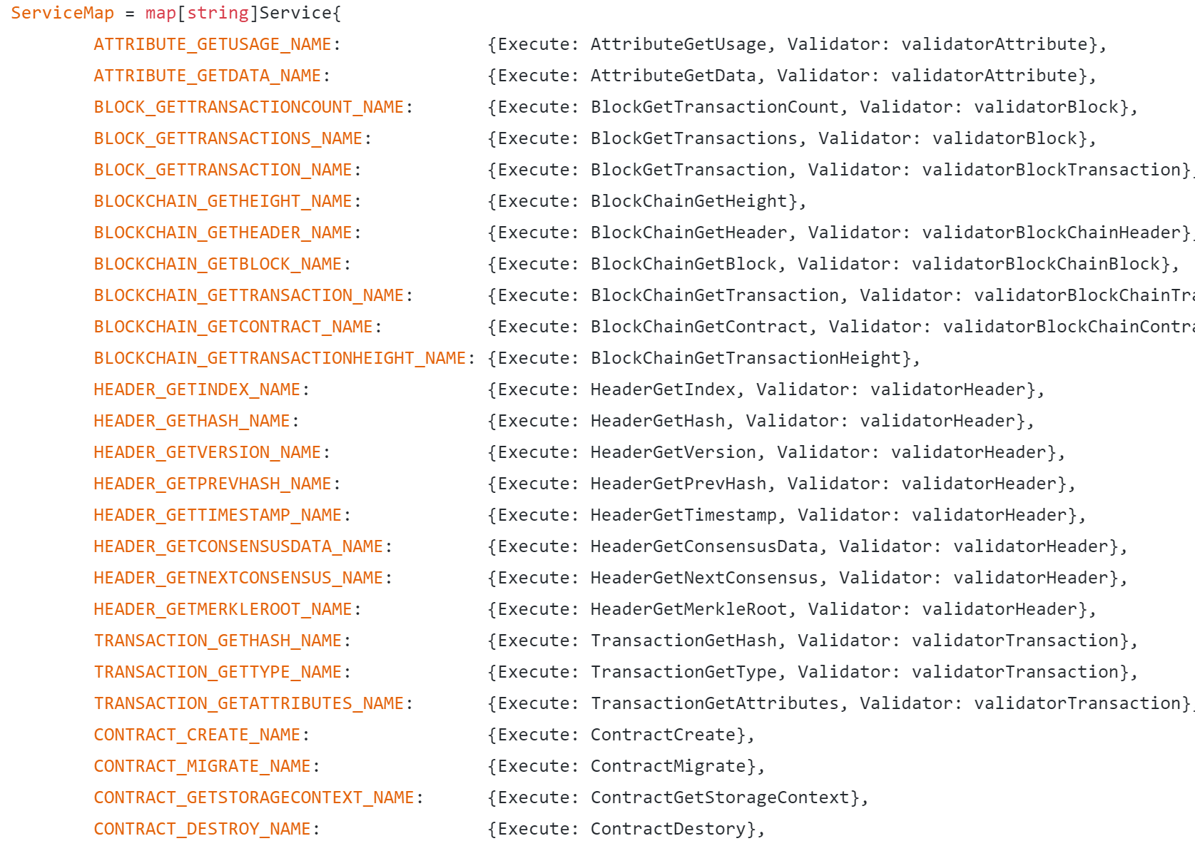
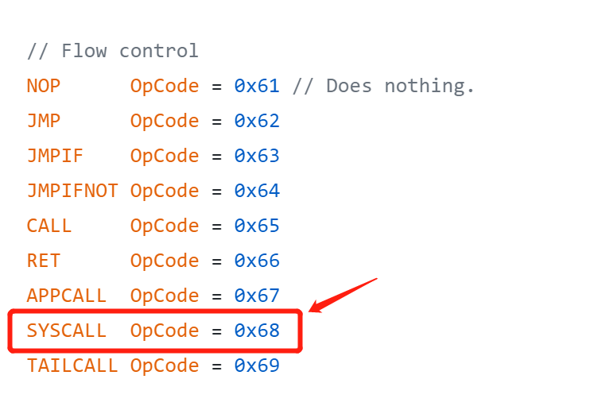
Smart contract syscall
Ont’syscall:
https://github.com/ontio/ontology/tree/master/smartcontract/service/
https://github.com/ontio/ontology/blob/master/vm/
Notes:
Let’s make the ont’s syscal as an example.
The figure on the right indicates that it has a syscall opcode .
This opcode helps the smart contract developer invoke the various functions provided by the node.
Such as the functions listed on the left figure.

Slide 27
Agenda
Background
Attack Surface Analysis
How to Find Vulnerabilities
Real Cases
Conclusion
Notes:
After analyzing these attack surfaces, let’s talk about how to find vulnerabilities in them.

Slide 28
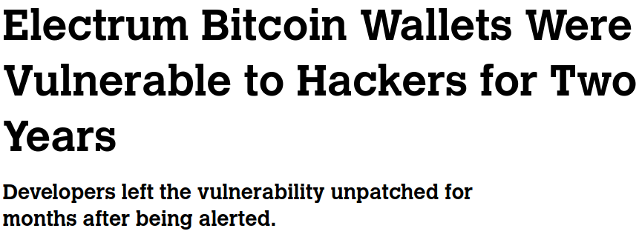
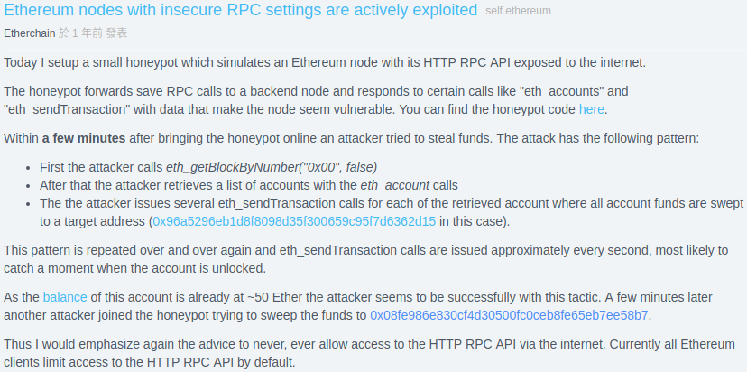
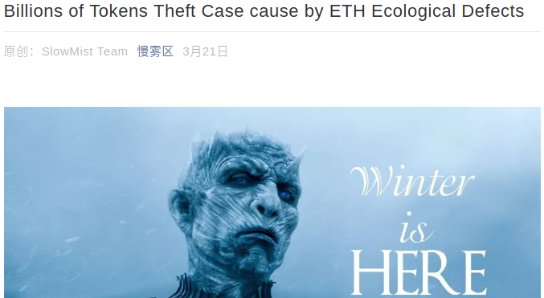
RPC Attack Case Study: ETH
Notes:
If the RPC interfaces are not protected well, it will result in very serious consequences.
Let us learning from a real case.
[CLK]
As early as 2016, one researcher claims that his honeypot has detected remote stealer in the Ethereum Network.
[CLK]
At the beginning of 2018, this kind of attack got reposted by different groups.
Although these kind of attack have been posted so many times, the attacks never stop.
[CLK]
By now, one of the most famous attacker’s accounts have stolen more than 44 thousands Ethers, which is the digital concurrency issued by Ethereum.
This account is still receiving stolen Ethers from day to day.
The stolen Ethers are worth of more than 5 million US dollars.

Slide 29

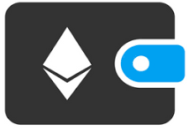
RPC Attack Case Study
Stealing Ethereum remotely:
Step 1. check target node’s RPC is open;
Step 2. get the information of the node’s wallet;
Step 3. command the node to send its balance.
Attack success condition:
Attacker knows the key to unlock account, OR…
Account is unlocked by owner.
Notes:
Let’s check out how an attacker can steal the Ethers from a victim’s node remotely.
First of all, he will check if the target node’s RPC is open;
If yes, he will try to query the wallet information from the node;
Then, he will command the node to send all its balance to the attacker’s account.
[CLK]
The success condition for the third step is that, the victim’s account should be unlocked to allow the Ethers to be sent out.
There are two different situations:
[CLK]
Situation 1, the attacker knows the password of the victim’s account.
However this is very hard to achieve.
[CLK]
The other situation is that the account is unlocked by its owner.
Under this situation, if the account is not relocked manually by the owner, there will be a time window for attacker to invoke the RPC interface of sending Ethers.

Slide 30
RPC Security Model
Risk Factors | ETH
No RPC Caller Identity Authentication | √
Unsafe Wallet Management | √
All User Nodes Detectable | √
Bitcoin
ⅹ^{#1}
√
√
EOS
√
√
ⅹ^{#2}
Ripple
√
ⅹ^{#3}
ⅹ^{#4}
NEO
√
√
√
Follow these three risks to find RPC problems in other blockchain networks.
Notes:
Let’s make a summary.
Ethereum nodes are vulnerable to RPC attacks because:
They expose their sensitive RPC interfaces and implement no effective caller identity authentication;
The node programs provide unsafe wallet management, such like unlocked wallet will leave a time window for transactions;
All user nodes are detectable. Otherwise, attackers could not find large amount of victims to steal.
[CLK]
Based on these three risk factors, let’s have a check on some other famous blockchain projects.
[CLK]
Bitcoin has implemented very effective RPC caller identity authentications.
The interfaces are ether protected by username and password or by keys.
Therefore, it is safe.
[CLK]
EOS network is divided into different levels.
All the users’ nodes are not connecting with each other by P2P protocol.
Therefore, even though the other two factors are matched, the threat of RPC attacks in EOS is very limited.
[CLK]
Ripple’s RPC interface don’t provide wallet management.
It only takes care of publishing transaction messages onto the network which is already signed by users, so that it is safe.
[CLK]
Lastly, NEO is a blockchain project which matches all these three factors.
The attacks in its network has already been analyzed by our team and the details will be discussed later.

Slide 31
How to Find Bugs in Code
Although there are hundreds of clients, there are few truly independently developed clients.
Most are copies and customizations of classical projects.
You just need to be familiar with several well-known clients.
Such as BTC,ETH,EOS and so on.
Notes:
now, let’s talk about how to find bugs in code
Although there are hundreds of blockchain clients, there are few truly independently developed clients.
Most are copies and customizations of classical projects.
So you just should be familiar with several well-known clients.
Such as BTC,ETH,EOS and so on.

Slide 32
How to Find Bugs in Code
If you want to fast analyze a new blockchain project, there are some different situations:
If the project is based of a classical project, easy to get started. You can check if it has any n-day bugs.
If it is an independent project:
Firstly, just download the source code, compile and run.
Secondly, you can use some tricks to quickly find some obvious bugs.
Finally, you need to go deep into the code. Locate each attack surface and audit them.
Notes:
If you want to fast analyze a new blockchain project, there are some different situations:
If the project is based of a classical project, easy to get started. You can check if it has any n-day bugs.
If it is an independent project,
firstly, it is not recommended to read the white paper directly, just download the source code, compile and run.
secondly, you can use some tricks to quickly find some obvious bugs.
Finally, you need to go deep into the code. Locate each attack surface and audit them.

Slide 33
Some Tricks
Blockchain clients are usually implemented in a variety of languages. Such as c++, go, java and so on.
The problem with c++ is obvious, since its pointers are prone to memory access errors.
Other languages also can cause problems, even without Pointers. Such as OOM,OOB and so on.
Even a DOS vulnerability can have a big impact on the blockchain, like breaking mining and user transactions.
It could even cause 51 percent of the attacks.
Notes:
Blockchain clients are usually implemented in a variety of languages. Such as c++, go, java and so on.
The problem with c++ is obvious, since its pointers are prone to memory access errors.
Other languages also can cause problems, even without Pointers. Such as OOM,OOB and so on.
Even a DOS vulnerability can have a big impact on the blockchain, like breaking mining and breaking user transactions.
It could even cause 51 percent of the attacks.

Slide 34
Some Tricks
Common bug situations :
Out of bound access.
Integer overflow.
Type conversion failed.
Map index does not exist and not checked.
Allocate memory is too large.
Race condition.
...
Most languages have all of the above problems.
Notes:
there are some common bug situations:
such as
Out of bound access.
Integer overflow.
Type conversion failed..
The map index does not exist and not checked.
Allocate memory is too large.
Race condition. and so on
Most languages have all the above problems.

Slide 35
Some Tricks
You could believe that a lot of blockchain code isn‘t of high quality. They will have many basic errors.
So you can summarize some vulnerability patterns for the languages you want to study.
Then use the patterns to search the source code directly.
You will be pleasantly surprised.
Notes:
You could believe that a lot of blockchain code isn't of high quality.
They will have many basic errors.
So you can summarize some vulnerability patterns for the languages you want to study.
Then use the patterns to search the source code directly.
You will be pleasantly surprised.

Slide 36
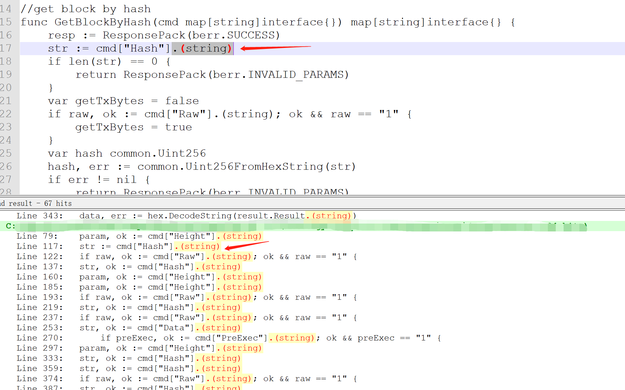
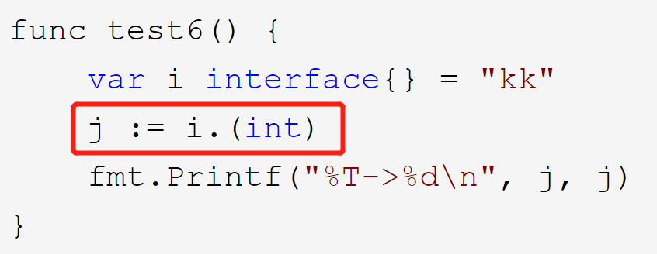
Example for go language
Type conversion:
\.\(string\)
\.\(int\)
If the conversion fails, the program will panic.
Notes:
Let’s make go language as an example
I write my own patterns using regular expressions.
You can also write more advanced search programs. It might work better.
Firstly, this is a pattern of type conversions.
such as string conversion and integer conversion.
In the go language, there is an unsafe type-conversion syntax.
Like the code shown in the figure, which will cause panic.
let’s look at an example, this is the result of a search for string type conversions in a blockchain project.
As you can see, it uses unsafe type conversions.
Because the converted value can be controlled by an attacker, it can cause panic.

Slide 37
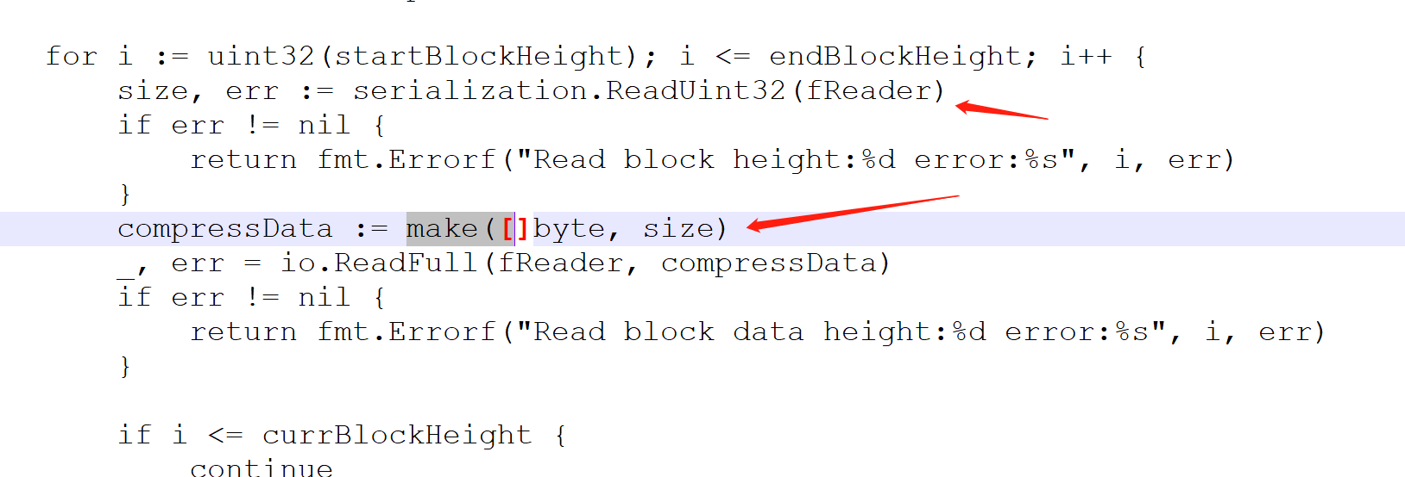
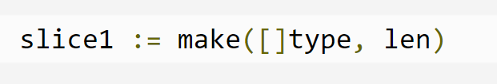
Example for go language
Allocate memory:
make\(\[
If the memory size is controllable by remote attacker, which will result in out of memory.
size is controllable by attacher
len is too large
Notes:
Secondly, this is a pattern of memory allocation.
In the go language, you can use ‘make’ to create dynamic array and initialize its size.
If the initial size is too large, it will cause out of memory. The program will exit.
This is an example that the result of a search for memory allocation in a blockchain project.
The memory size is controllable by remote attacker, which will result in out of memory.

Slide 38
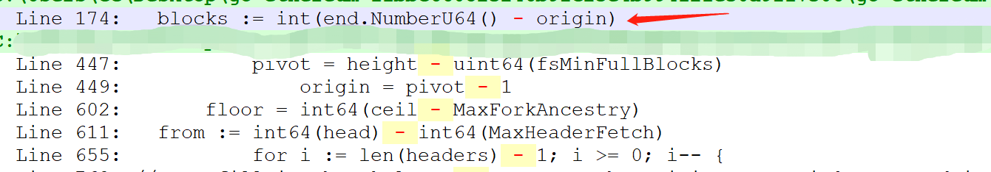
Example for go language
Integer overflow:
\s\*\s \s\+\s \s\-\s
Integer overflow errors are very common, and may have serious consequences.
end - origin
Notes:
Thirdly, this is a pattern of integer overflow.
Integer overflow errors are very common, and may have serious consequences.
Pattern matching for integer overflow is not easy.
It has a lot of matches and a lot of filtering to do.
This is an example that the result of a search for integer overflow in a blockchain project.
‘End’ field and ‘origin’ field can be controlled by attackers.
Integer overflow occurs when end is less than origin.

Slide 39
Example for go language
Out of bound of arrary:
\[.+\]
Find the code that associated with array access.
Incorrect map index:
First find “make(map“ , then looking for reference to the map.
Race condition:
^\s*go\s
Focus on pipes, global variables, and other resources shared by multiple threads.
Notes:
There are some other patterns.
Firstly, Out of bound access.
It often happens when arrays are accessed
So, this regular expression is used to find the code that associated with array access.
Secondly , incorrect map index:
If there is no index in the map, the extracted result will be empty, if there is code to access it with no checking, it will cause problems.
To find out this problem, first of all you should get all map objects by find “make map”, and then check it usage by reference.
Many IDE have the ability to find references.
Thirdly,
Race condition: It often happens in multithreading
Therefore, we look for multithreaded functions and audit the code of them.
We can focus on pipes, global variables, and other resources shared by multiple threads.
Notice that the above patterns are all based on the go syntax.
Different languages have different syntax, you need to write patterns for other languages.

Slide 40
Deep analysis into code
If you want to find more vulnerabilities, you need to go deep into the code.
It will take more time, because you need to understand all kinds of protocols and algorithms..
It also has some tricks. You just need to follow the direction of the attack surfaces, then you won't get lost in the ocean of code.
Notes:
If you want to find more vulnerabilities, you need to go deep into the code.
It will take more time, because you need to understand all kinds of protocols and algorithms.
It also has some tricks. You just need to follow the direction of the attack surfaces, then you won't get lost in the ocean of code.

Slide 41
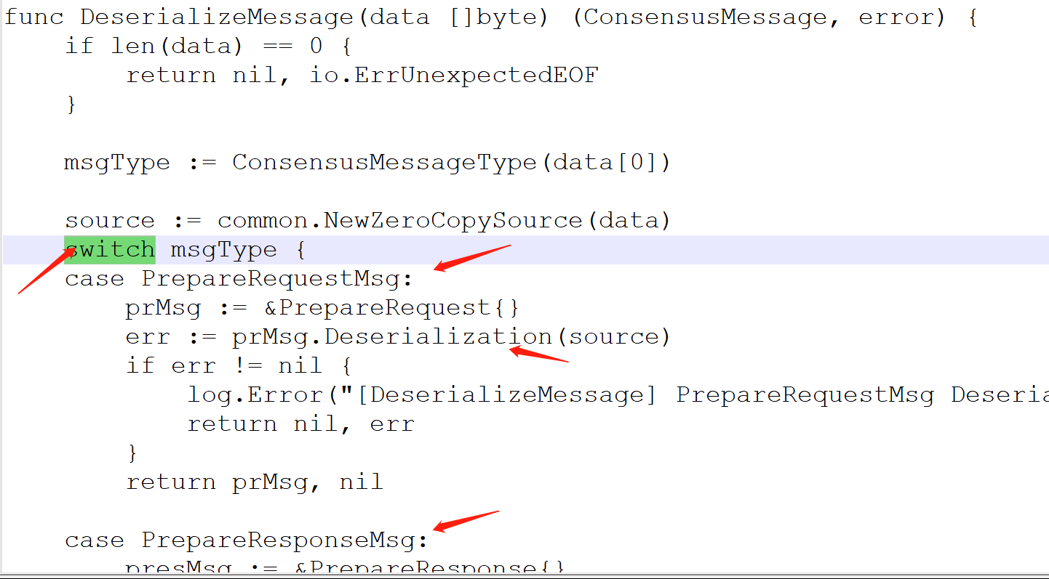
Fast locate attack surface code
Guess the Functionalities base on the file names.
We are more concerned about “p2p”,”rpc”,”mesage” and so on.
Search source code:
Search “switch”:
Many protocols have a switch for parsing.
Search “send” or “recv” or “server.start”:
Find network-related apis.
Search “message” or “packet”:
Find the code associated with the packet or message.
Search “marshal” or “serialize”:
Find the code associated with marshal.
Notes:
How to locate the attack surface?
Of course, it's certainly possible to read the entire code.
However, this is time-consuming.
Here, I'll give you some quick ways to locate it.
firstly:
guess the Functionalities base on the file names.
We are more concerned about “p2p”,”rpc”,”mesage” and so on.
secondly:
we Search source code with keywords:
num1 “switch” ,Many protocols have a switch for parsing.
num2 “send” or “recv” or “server.start”:
these are network-related codes.
num3 “message” or “packet”:
these are the code associated with the packet or message.
num4 “marshal” or “serialize”:
Find the code associated with marshal.
For example,this is a typical message parsing entry
It contains key words such as switch, message, and deserialization
When we find these key points, it is much easier to audit around them.

Slide 42
Smart Contract VM Vulnerability Mining
Fuzzing
Format-based (WASM & Solidity ...)
Suitable for smart fuzzing (AFL & LibFuzzer)
Need to write a wrapper for the parsing, interpreting, JIT compiler …
Code Auditing
Aiming at the parsing, interpreting, JIT compiler …
Fuzzing can help to locate code segments with low quality.
Notes:
For smart contract Virtual Machine vulnerability mining, we can do fuzzing or code auditing.
The contracts, which are deployed and called in the blockchain networks are all serialized data following certain format.
If we can write a wrapper for some certain functionalities such like parsing and interpreting, then it is suitable to do format fuzzing.
Of course, code auditing is also suitable in this situation.
It requires us to have a deep understanding on the implementation of the entire VM to help locate vulnerable components.
Sometimes fuzzing can help to locate code segments with low quality.

Slide 43
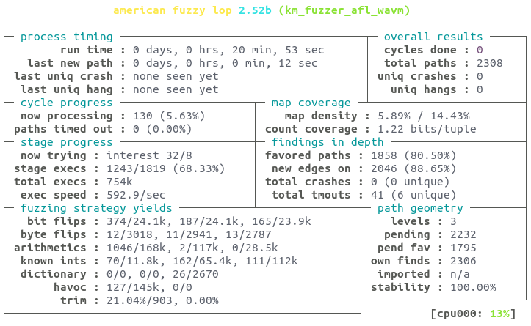
Fuzzing on Smart Contract VM
Real Case: AFL fuzzing on wavm runtime of EOS
Notes:
This page presents a real case of fuzzing with AFL on the smart contract runtime of EOS nodes.
The EOS node implement its smart contract runtime based on two 3rd-pary open source projects name WAVM and Binaryen.
I have extracted the wrapper code of WAVM and implemented this one program which can take a bytecode file as an input to make parsing and interpreting.
Therefore, this program is applicable to AFL fuzzing.
// Sadly, this does not find any new vulnerabilities.

Slide 44
Agenda
Background
Attack Surface Analysis
How to Find Vulnerabilities
Real Cases
Conclusion
Notes:
Now, let’s have a look at the real cases of vulnerabilities in different attacker interfaces.

Slide 45
Real Case Overview
Malicious
Rmote Node
RPC MSG
P2P MSG
SmartContract
P2P Interface
SmartContract
RPC
Discover
SYN
Consensus
(ETH,NEO)
interpreting
syscalls
……
Protocol
Protocol
Protocol
(EOS)
(EOS)
(ETH)
(ETH)
(BTC,ONT)
Block Chain Server Node
Notes:
In this section, we will analyze some real vulnerabilities in various top blockchain projects like Ethereum, EOS, BTC , NEO and ONT.

Slide 46
Real Case Overview
Malicious
Rmote Node
RPC MSG
P2P MSG
SmartContract
P2P Interface
SmartContract
RPC
Discover
SYN
Consensus
(ETH,NEO)
interpreting
syscalls
……
Protocol
Protocol
Protocol
(EOS)
(EOS)
(ETH)
(ETH)
(BTC,ONT)
Block Chain Server Node
Notes:
In this section, we will analyze some real vulnerabilities in various top blockchain projects like Ethereum, EOS, BTC , NEO and ONT.

Slide 47
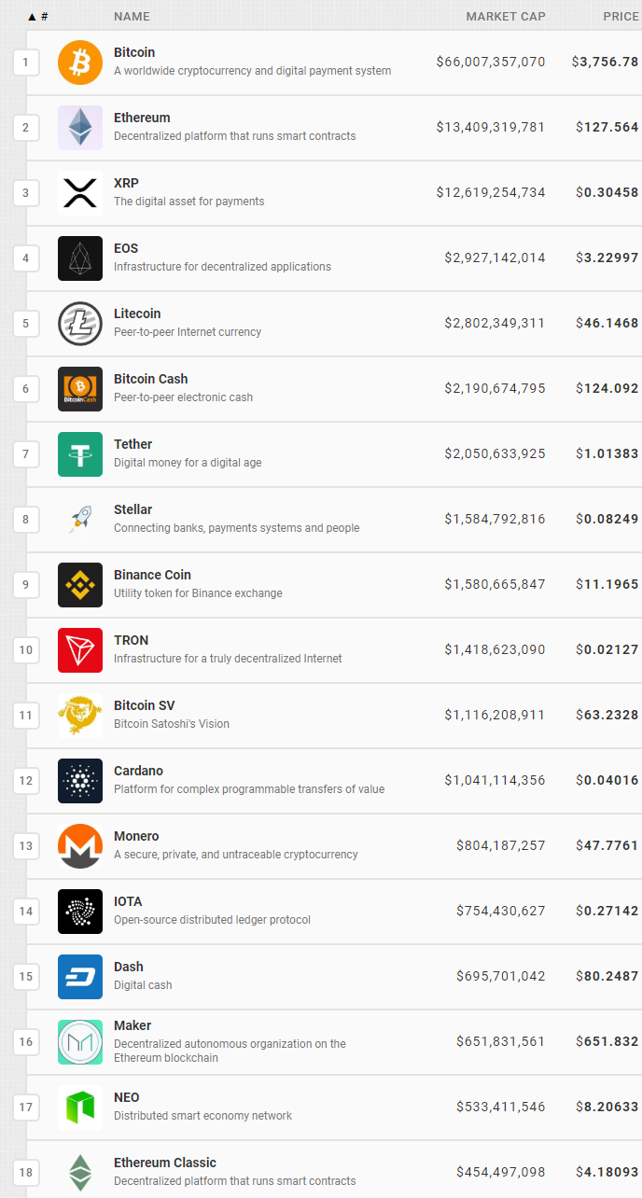
RPC Security Problems
Platforms: Ethereum, NEO;
Three questions to answer:
How many nodes are vulnerable?
How serious are the attacks?
What measures are attackers leveraging?
Notes:
First of all, let’s have a look at the RPC security problems.
There are two projects found to be vulnerable to this kind of problem as introduced in our previous pages.
[CLK]
Ethereum is the second blockchain project according to its market value and NEO is among the top twenty.
[CLK]
In order to have a comprehensive research on the RPC attacks, we will need to figure out the following three questions:
……

Slide 48
Analysis System on RPC Attacks
Analysis System
Honey-pot
Victim Sniffer
Capture Malicious RPC Requests, Find New Attack Measures
Network-Wide Node Detector
Sniff Victim Nodes, Check Exposed RPC Interfaces
Blockchain Network
Attacker Node
Victim Node
Normal Node
Notes:
In order to figure out these questions, we have developed an analysis system.
It contains a honeypot, a victim sniffer and a node detector.
The honeypot will capture malicious RPC requests and find new attack measures from these requests.
The victim sniffer will find out the nodes in the blockchain network whose RPC interfaces are exposed.
The node detector is a special component which can found all nodes in the target blockchain network.
It is the basic of the other two component.

Slide 49

Network-Wide Node Detector
Basic Idea
Query the neighbor lists of all known nodes.
Implementation
Modify the source code of nodes;
Imitate the P2P protocol.
Effect
Make honeypot easier to be found by attackers;
Provide candidate list for Victim Sniffer.
Notes:
First of all, let’s see how to implement a node detector.
The basic idea is to query the all already-known nodes about their neighbor node lists.
This can be implemented by modifying the source code of nodes or imitating the P2P protocol ourselves.
The effect of this component is that:
On one hand, it can make the honeypot easier to be found by attackers if they are deployed on one network device;
On the other hand, it can provide a candidate list for the Victim Sniffer to find vulnerable nodes.

Slide 50

Honeypot
Basic Idea
Capture Request → Craft Response → Make Record
Implementation
Deploy a normal node for the honeypot to query data;
Only craft response for special interfaces.
Two Kinds of Special Interfaces:
Sensitive data query;
Leveraged by attackers.
Notes:
Honeypot is another component in this system.
The basic idea is to capture request, craft response and make record.
To ensure the authenticity of the response, we can deploy a normal node for the honeypot to query data.
In this way, we only need to craft responses for some special interfaces.
There are two kinds of special interfaces:
The first are the interfaces that can be leveraged to query sensitive data, such as account addresses;
The second are those interfaces that have been found to be leveraged by attackers.

Slide 51
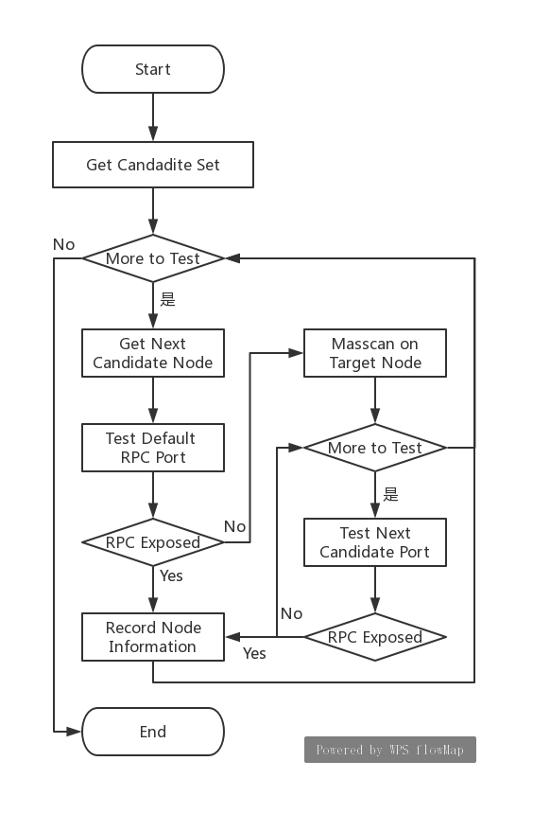

Victim Sniffer
Basic Idea
Find all the vulnerable nodes in the blockchain network;
Difficulties
How to reduce the candidate set;
How to find nodes that modified the default RPC port.
Implementation:
Take the result of Network-Wide Node Detector as a candidate list;
Leverage Masscan to get all exposed port.
Notes:
Victim Sniffer is the third component.
It is used to find all the vulnerable nodes in the blockchain network.
It will take the result of Node Detector as a candidate list for testing, which can help to reduce the candidate list size.
First of all, it will check if the default RPC ports of these candidate nodes are exposed.
Furthermore, to find vulnerable nodes that have changed the default RPC port, our sniffer will leverage a very powerful tool, named Masscan, to get all the exposed port of a candidate node to do further test.

Slide 52
Case 1: RPC Attack Analysis on Ethereum
Test Node Configures
Test Result Summaries (test last for 1 month…)
Location | CPU | Memory | Bandwidth | Storage
Hong Kong | 1 Core | 1GB | 2Mbps | 50GB HDD
Silicon Valley | 1 Core | 1GB | 1Mbps | 50GB HDD
Frankfurt | 1 Core | 1GB | 1Mbps | 50GB HDD
Node | Captured RPC Requests | Detected Node Count | Victim Node Count
Hong Kong | 11,614,335 | 69,332 | 1,757
Silicon Valley | 41,984,376 | 74,636 | 1,779
Frankfurt | 36,508,897 | 86,599 | 1,804
Notes:
This analysis system is firstly applied on Ethereum.
We have deployed three test nodes on Tencent Cloud which located at Asia, Europe and America.
The cost of deploying these nodes are not very expensive which are about fourteen US dollars one month.
These nodes only have a single-core CPU, 1 GB Memory, 1 or 2 Mbps of bandwidth and 50 BG of storage.
[CLK]
The test lasted for one month.
The summaries of the test results of different nodes are shown in the second table.
The honeypots have captured tens of millions illegal requests.
The node detectors have found as many as 86 thousand nodes.
Amount them, more than 1 thousand and 8 hundred nodes are found vulnerable.

Slide 53
Case 1: RPC Attack Analysis on Ethereum
Three findings based on test result:
Stealing targets contain not only Ethers but also some Tokens;
Victim’s accounts may under the threat of brute-force attack;
Victim nodes may lose their mining award.
Node | Attacker’s Accounts | Target TOKENS | Vulnerable Nodes | Threatened Accounts
Hong Kong | 35 | 0 | 158 | 53,082
Silicon Valley | 36 | 22 | 163 | 54,095
Frankfurt | 17 | 21 | 165 | 54,220
Node | Dictionary Size | Vulnerable Nodes | Threatened Accounts
Hong Kong | 731 | 123 | 53,043
Silicon Valley | 721 | 124 | 54,050
Frankfurt | 629 | 126 | 54,176
Node | Attacker’s Accounts | Vulnerable Nodes / Vulnerable Miner
Hong Kong | 0 | 54 / 8
Silicon Valley | 2 | 54 / 7
Frankfurt | 1 | 53 / 8
Notes:
If we make a deeper study into the test results, we can conclude three finds:
[CLK] No 1, the stealing targets contain not only Ethers, which are the main digital concurrency issued by Ethereum, but also the Tokens, which are implemented by the smart contract of Ethereum.
[CLK] No 2, victims accounts may under the thread of brute-force attack.
According to our honeypots, the password dictionary used by attackers contains more than 7 hundred items.
[CLK] No 3, victims nodes may lose their mining award.
Although the captured attackers’ account are not many, there are more than 50 nodes are vulnerable and some of them were just mining during our test.

Slide 54
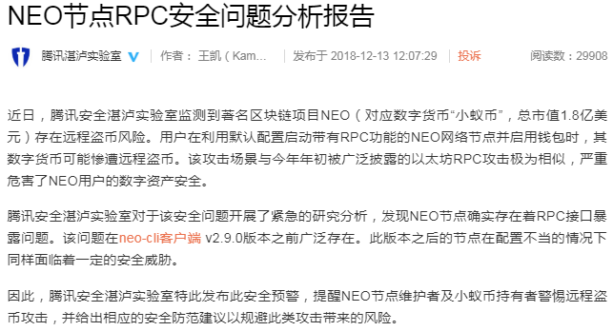
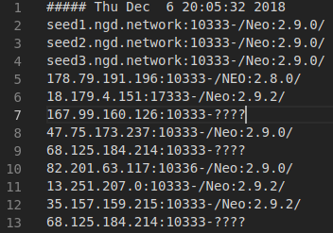
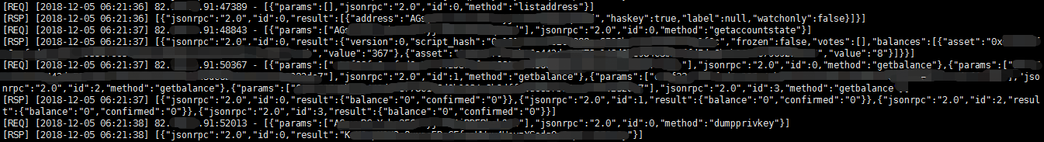
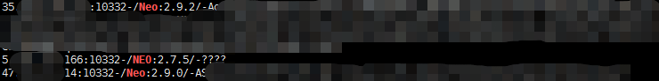
Case 2: RPC Attack Analysis on NEO
Our lab has exclusively disclosed the attacks (In Chinese):
Honeypot has captured the malicious requests in the wild;
Node Detector is implemented by imitate NEO’s P2P protocol;
Victim Sniffer has found 13.6% of NEO nodes exposed their RPC interfaces.
Notes:
Our analysis system is also deployed on NEO blockchain.
Our lab has exclusively disclosed the attacks on Dec of last year.
[CLK]
The attack measures captured by our honeypot are shown as the picture.
[CLK]
The node detector is implemented by analyzing and imitating the NEO’s P2P protocol, which successfully detected all the nodes in NEO network.
[CLK]
Our victim detector has found more than thirteen percent of the NEO nodes are under the threat of remote RPC attack.
In conclusion, the RPC attacks in different blockchain projects have similarities.
The analysis system we shared here is portable for them.

Slide 55
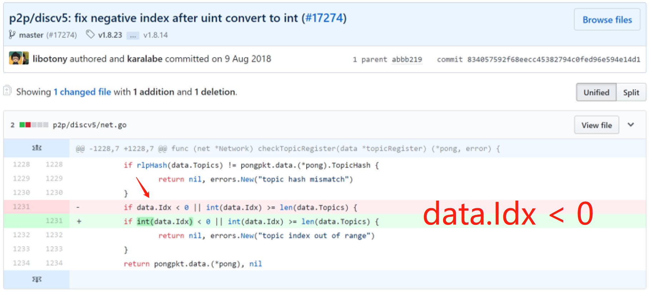
P2P DISCOVER PROTOCOL: ETH
Remote DOS using malicious request in Discv5 protocol.
POC：net.conn.sendTopicRegister(n, gtps, -1, gpk.rawData)
https://github.com/ethereum/go-ethereum/commit/834057592f68eecc45382794c0fed96e594e14d1
Notes:
Next, let's look at an example of ethereum's p2p discovery protocol
The problem occurred in the ethereum p2p discovery protocol when checking topicRegister packets.
The idx field of the packet is defined as Unsigned integer type, which is not converted to integer when checked, resulting in check failure and overflow access.
Attackers can modify the client code, call the sendTopicRegister function to set idx to -1.
it will cause remote DOS to the target node.
The fix for the bug is as simple as converting idx to integer

Slide 56
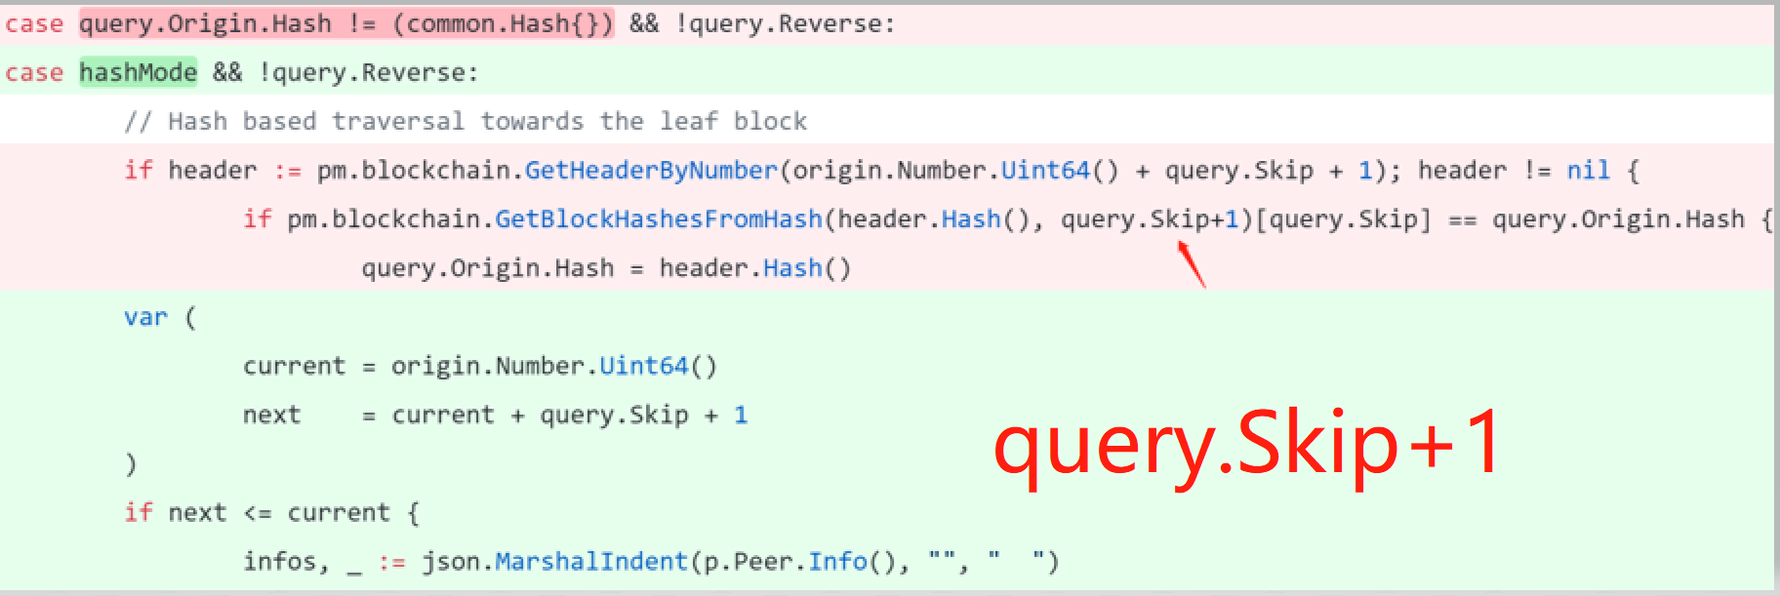
P2P SYN PROTOCOL:ETH
Remote DOS using malicious GetBlockHeadersMsg request in LES protocol.
POC: Send a GetBlockHeadersMsg request with query.Skip set to -1.
https://github.com/ethereum/go-ethereum/commit/a5237a27eaf81946a3edb4fafe13ed6359d119e4
Notes:
Next, let's look at an example of ethereum p2p synchronization protocol.
This problem occurs in the synchronization protocol of ethereum light node when processing GetBlockHeadersMsg messages.
As shown in the figure, the skip field of the packet is controllable by attacker.
and there is no check for integer overflow when it pluses one
This leads to out-of-bounds access.
An attacker can modify the client and send a GetBlockHeadersMsg message that sets the skip field to -1.
it will cause the target node DOS.

Slide 57
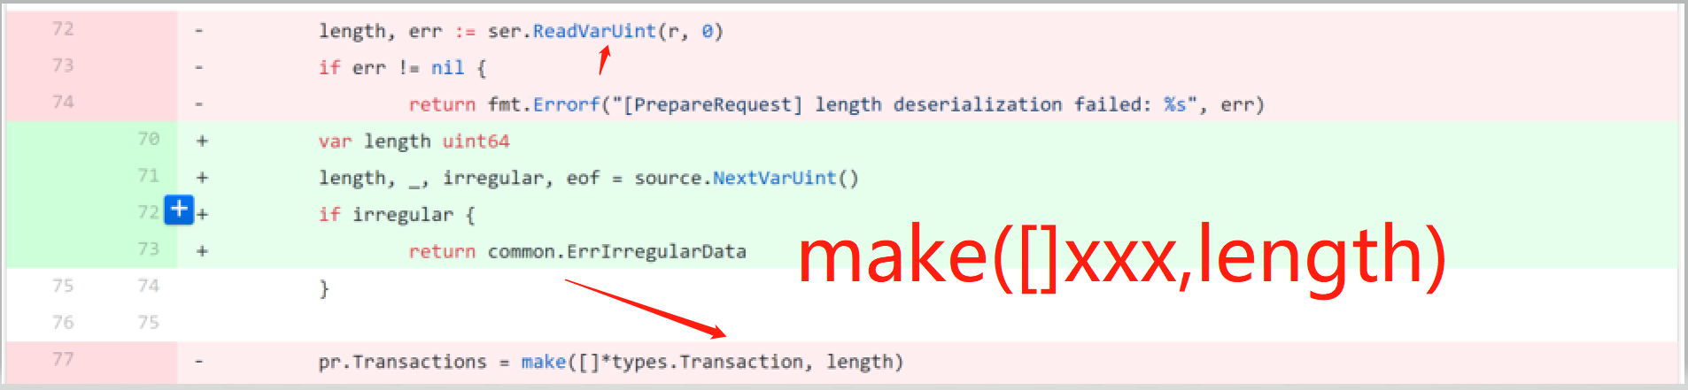
P2P CONSENSUS PROTOCOL:ONT
Remote DOS using malicious request in DBFT protocol.
Function:func (pr *PrepareRequest) Deserialize(r io.Reader) error
POC：Send a PrepareRequest with Transactions’s length set to -1
https://github.com/ontio/ontology/commit/1f15dc223145381aa686bd829aeb56b0c1f86e34
Notes:
This is a case of ont's p2p consensus protocol.
This problem occurs in the DBFT consensus protocol in ONT when processing PrepareRequest messages.
As shown in the figure, it creates an array by length.
however the length is controllable by attacker.
and there is no check for its value
This leads to out of memory
An attacker can modify the client and send a PrepareRequest message that sets the length field to -1,
it will cause the target node DOS.

Slide 58

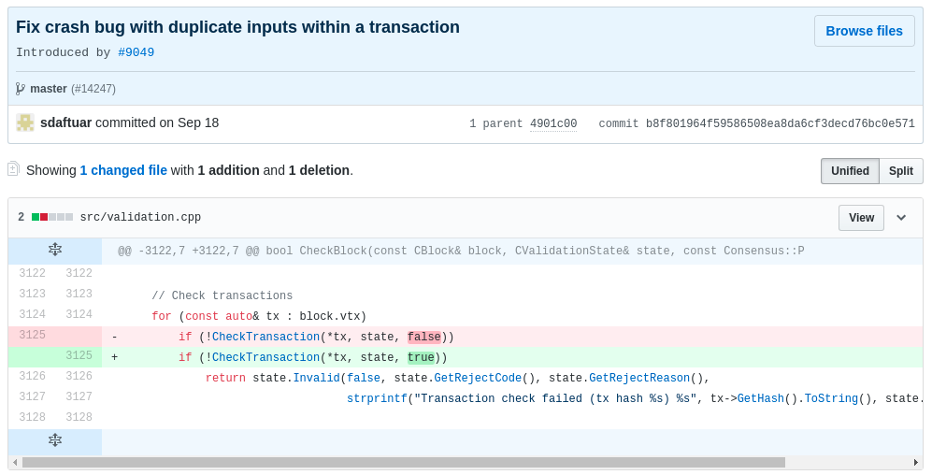
P2P CONSENSUS PROTOCOL: BTC
CVE-2018-17144 of BitcoinCore;
Fix: Reenable transaction checks on a block;
DoS && Double-Spend.
DoS Attack:
1: tx1 = create_tx_with_script(block1.vtx[0], 0, script_sig=b'\x51', amount=50 * COIN)
2: tx2 = create_tx_with_script(tx1, 0, script_sig=b'\x51', amount=50 * COIN)
3: block2.vtx.extend([tx1, tx2])
4: block2.vtx[2].vin.append(block2.vtx[2].vin[0])
5: block2.vtx[2].rehash()
Double Spend Attack:
1: block1 = create_block(tip, create_coinbase(height, n0_pubk), block_time) # reward 50 BTC
2: tx2_raw = node0.createrawtransaction(
inputs = [{"txid": block1.vtx[0].hash, "vout": 0}, {"txid": block1.vtx[0].hash, "vout": 0}],
outputs = {n1_addr: 100}
)
3: tx2_sig = node0.signrawtransactionwithwallet(tx2_raw)
4: tx2_hex = tx2_sig["hex"]
5: tct2 = CTransaction()
6: tct2.deserialize(BytesIO(hex_str_to_bytes(tx2_hex)))
7: block2.vtx.extend([tct2])
Notes:
This vulnerability has a CVE number.
The vulnerable program, BitcoinCore, is a popular client of Bitcoin.
[CLK]
The vulnerability exists in the transaction validation process of a newly received block.
As shown in this picture, when CheckTransaction is called with the third parameter set to True, it will enable the check for duplicate inputs within a transaction.
However, this check is very time consuming.
Therefore, developers disabled it because they believed that the detailed transaction handling code could take good care of these kind of unusual situation.
Unfortunately, it didn’t.
[CLK]
Attackers can leverage a malformed block to cause the crash of normal nodes or successfully double spend his balance.
[CLK]
To achieve DoS attack, tx2 is forged to contain tx1 as an input twice.
In this attack, tx1 and tx2 is recorded in the same block.
[CLK]
If tx1 is recorded in a previous block, tx2 will not cause a DoS.
Instead, other nodes will believe that tx2 is valid, which will result in the double-spend problem.

Slide 59
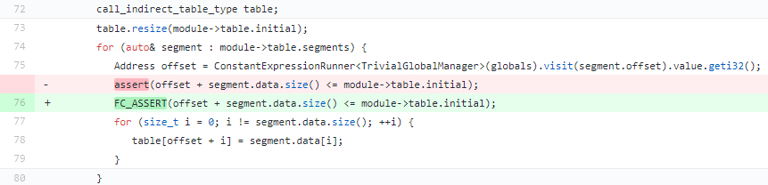
Smart Contract Interpreting: EOS
Integer overflow results in OOM Write;
Fix: Convert assert() into throwing exceptions;
Tips of EXP:
table is a local std::vector container;
This OOB can be used to overwrite another module’s opcode;
Then the overwritten module can be invoked to do arbitrary memory read and write.
①
②
③
Notes:
This vulnerability exists in the smart contract interpreting process of EOS nodes.
Its smart contract is in the format of WASM.
When a new smart contract is deployed on the network, nodes will parse and interpret its bytecodes.
Vulnerability exists in the interpreting process.
At location 1, the variable offset is an attacker controllable integer.
Before fix, the value of offset is validated to prevent integer overflow using assert function.
However, assert is not applicable for non-debug version.
Therefore, the local variable table will be leveraged to implement out of bound write at location 3.
To exploit this vulnerability, we can overwrite another module’s opcode and then invoke this module to do arbitrary memory read and write.

Slide 60
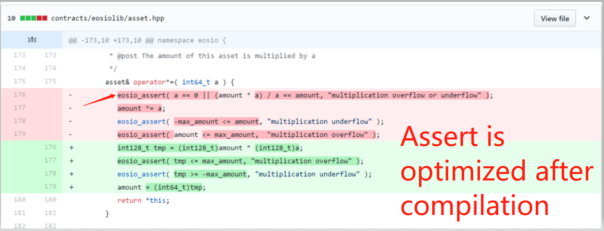
Smart Contract API:EOS
Integer overflow sycall
Compiler optimization results
https://github.com/EOSIO/eos/commit/b7b34e5b794e323cdc306ca2764973e1ee0d168f
Notes:
This is a problem that occurs in the smart contract API for EOS.
The function of the API is to calculate a multiplication
It has an error checking for overflow
The problem is very subtle
As shown in the figure, its check is implemented from the source code
However when compiled to wasm, the assert check is optimized.
Therefore, the overflow check fails.

Slide 61
Agenda
Background
Attack Surface Analysis
How to Find Vulnerabilities
Real Cases
Conclusion
Notes:
Now, let’s make a conclusion.

Slide 62
Conclusion
The increasing market value of digital concurrencies has attracted lots of attackers’ attention on blockchain security;
As a new technique, blockchain projects have exposed different kinds of attack surfaces;
These attack surfaces have been found to have real security problems, even attack events;
While blockchain technology is being applied in more industry fields, new security problems will bring more serious threat and harm;
Therefore, making more in-depth study on the blockchain security is very important in the further.

Slide 63
Thank You! ? & #
Contact us: abnernchen, kamewang@tencent.com

